Slide 1
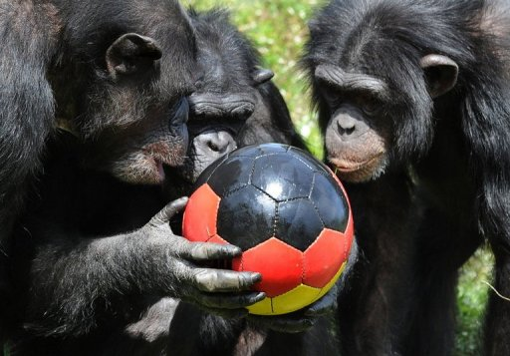
Protein folding, aggregation & hydrophobicity with simple physical models
Where physics and biology meet
Sanne Abeln VU University s.abeln@vu.nl

Slide 2
My Background
First Degree: Computer Science / Mathematics
(University of Manchester)
PhD: Structural Bioinformatics / Biochemistry
(University of Oxford)
PostDoc: Computational Biophysics in the Frenkel group
(Amolf, Amsterdam)
Currently, Associate Professor Bioinformatics
(VU University), use all of the above

Slide 3
The biological approach or the physical approach?
  TASK:
  Given a protein sequence predict in which 3D structure the protein will fold.
  Two approaches:

Slide 4
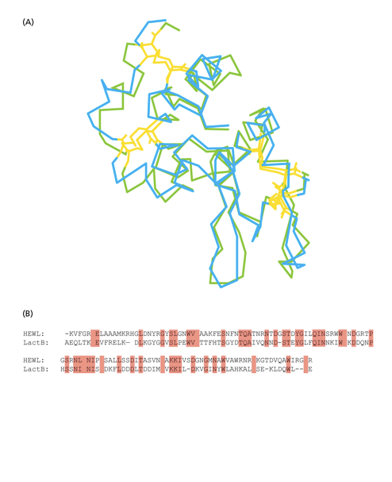
Biological Approach
Find a known structure with a similar sequence
Align the sequences
Model the unkown structure on the known structure using the alignment

Slide 5
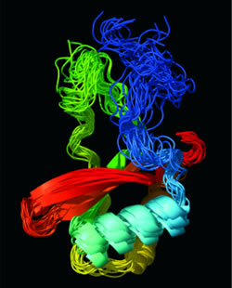
Physical Approach
Take a full atomistic force field
Simulate as long as possible

Slide 6
The biological approach or the physical approach?
  TASK:
  Given a protein sequence predict in which 3D structure the protein will fold.
  Who wins, the physical or biological approach?
  What about the machine learning approach?

Slide 7
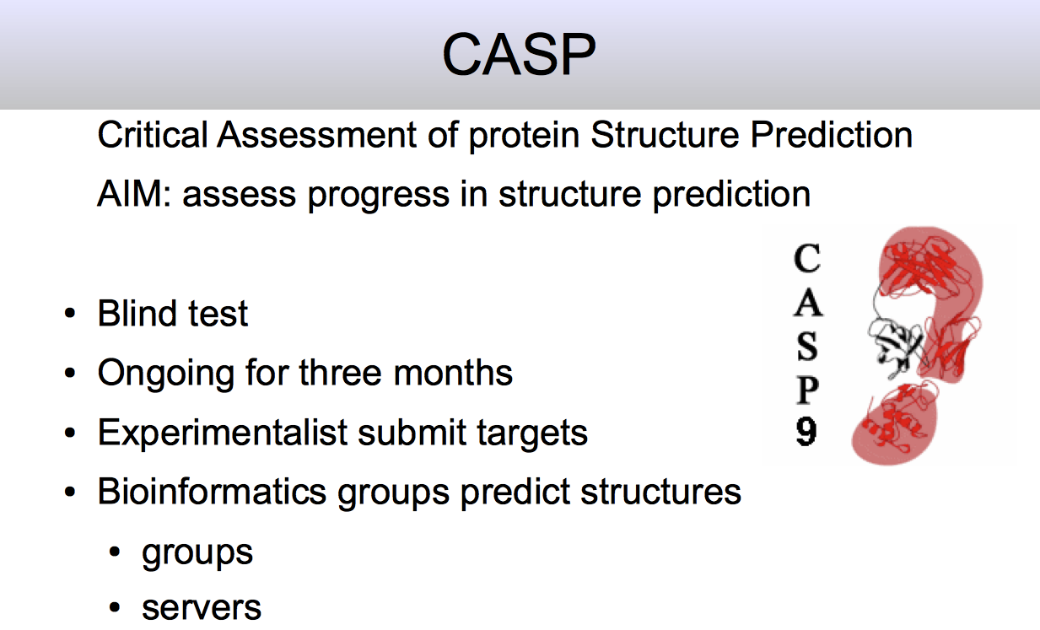
Major progress in last 4 years due to machine learning

Slide 8
Typical CASP results

Slide 9
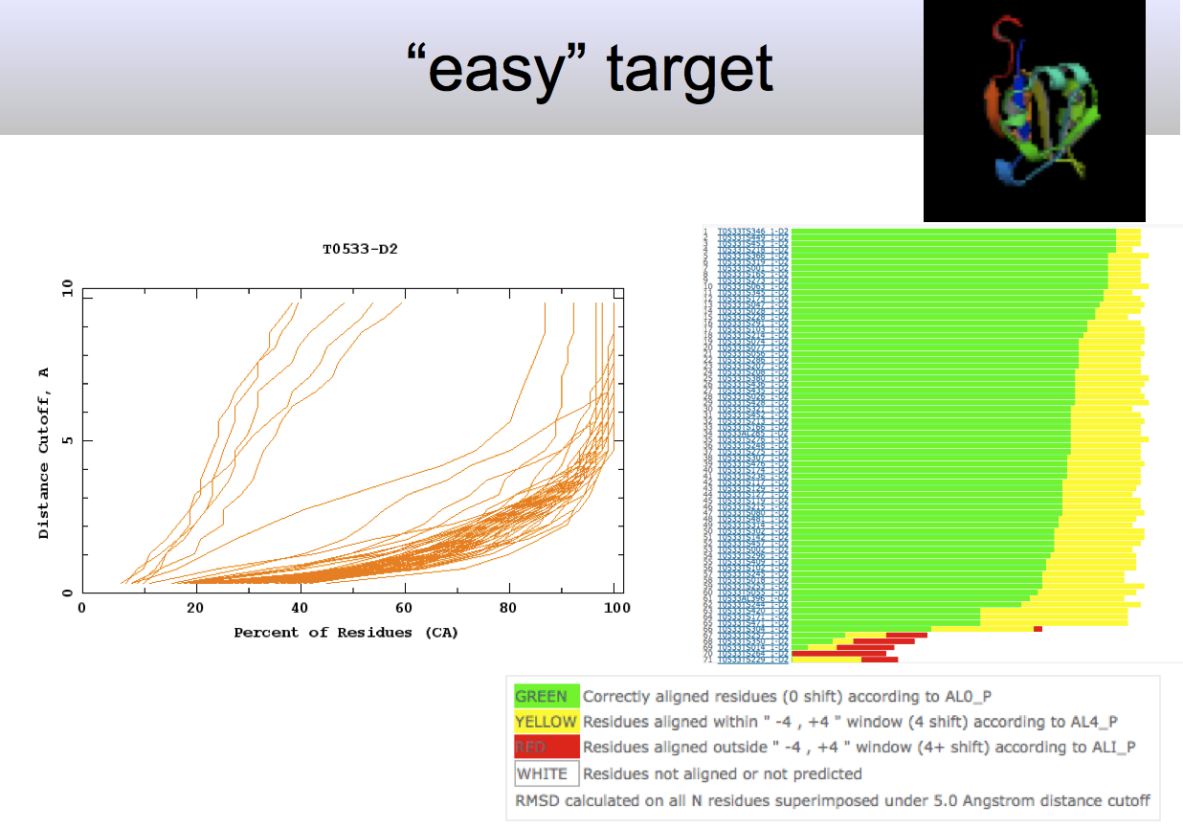
for ‘easy’ target structures with similar sequences are available
Notes:
Here biology is clearly outperforming physics!

Slide 10
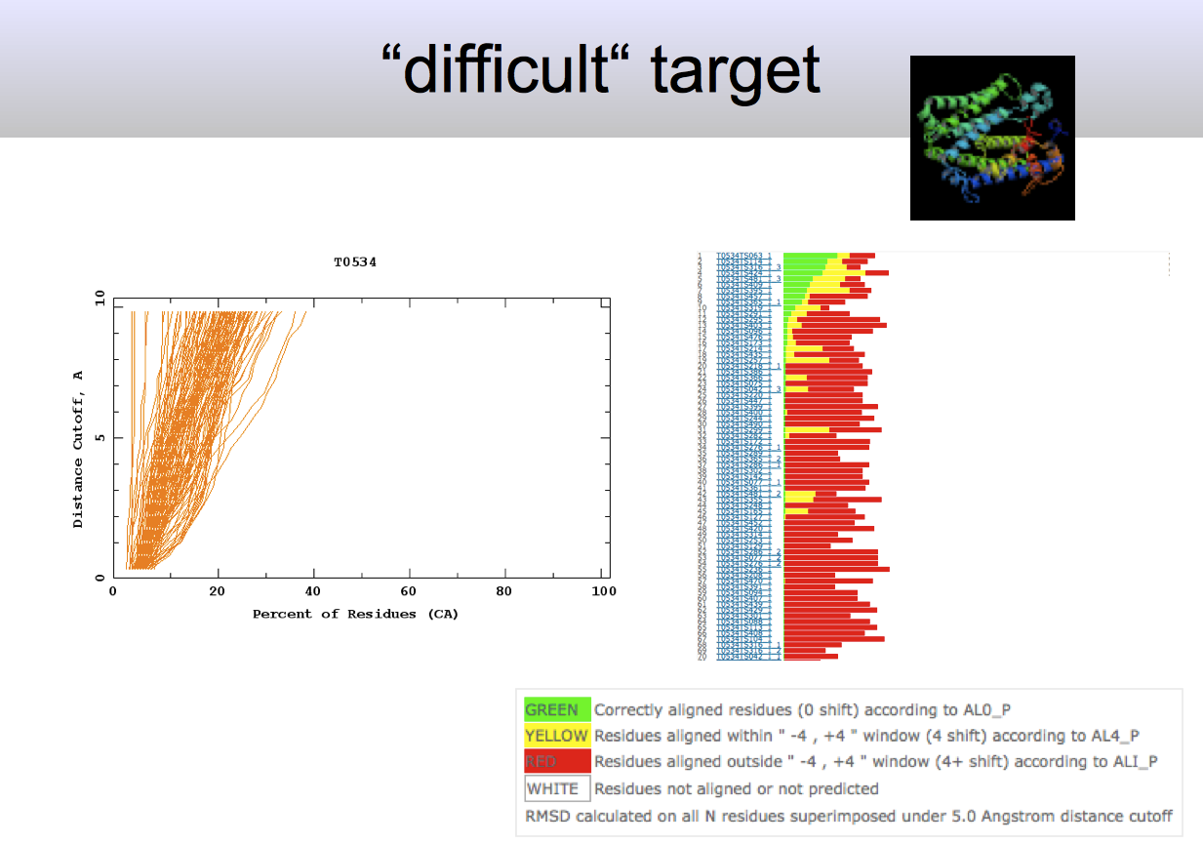

Slide 11
Biology versus physical
Only when a structural template is available, recognised by evolutionary sequence conservation can we model the structure correctly.
Biology wins…
Review available https://arxiv.org/abs/1712.00407

Slide 12
CASP 2019
Improved machine learning
Performance of models:
Kryshtafovych, Andriy, Torsten Schwede, Maya Topf, Krzysztof Fidelis, and John Moult. 2019. “Critical Assessment of Methods of Protein Structure Prediction (CASP)—Round XIII.” Proteins: Structure, Function and Bioinformatics. https://doi.org/10.1002/prot.25823.
Evolution > machine learning > physical principles

Slide 13
The most successful approaches do not adhere to statistical mechanics principles

Slide 14
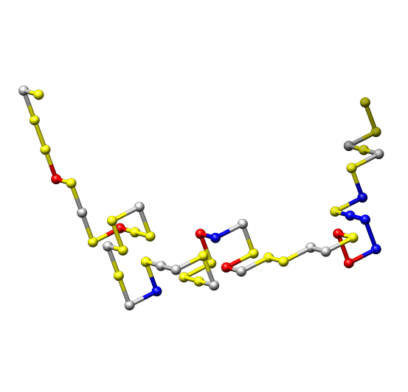
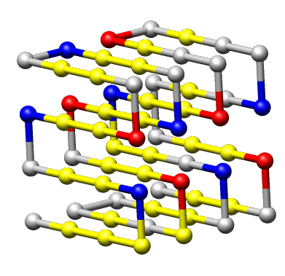
Biomolecular simulation (this afternoon)
Sequence
Structure
hydrophobic
polar (hydrophilic)‏
-- | + | + | +
+
+ |  | + | -
+ |  | - | +
negative charge
positive charge
Notes:
Matrix !!!!

Slide 15
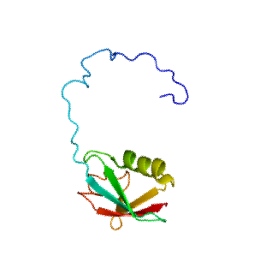
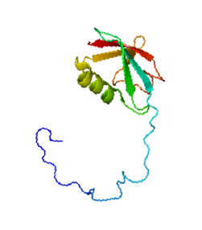
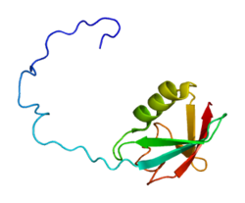
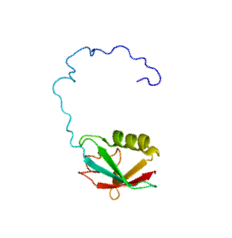
Folding physical process
Under physiological conditions, (most) proteins fold spontaneously and reversibly
(the precise folding path is rarely important)

Slide 16
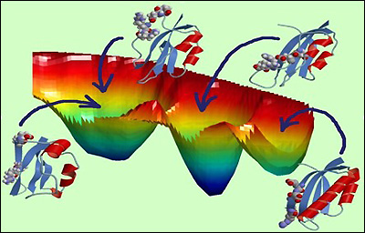
Free energy of proteins
The folded states is, under physiological conditions, the most likely state
(the stability of the folded state)

Slide 17
Why do proteins fold?
Let us consider the key physical forces that make proteins stable
We stay away from quantum mechanics for now.
Notes:
1 Hydrophobicity (oil in water)
2 Hydrogen bonds form secondary structure

Slide 18
What type of forces and effects would be relevant?
Van der Waals
Electrostatics
Hydrogen bonding
Entropic effects
Hydrophobic effect

Slide 19
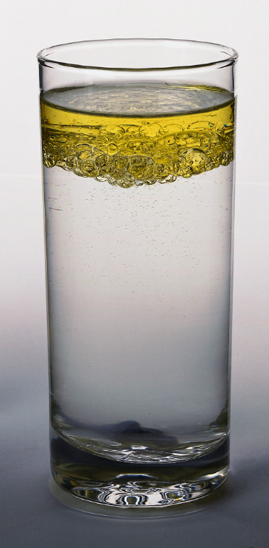
Hydrophobic effect
Oil and water do not mix well
Notes:
H: hydrogen bond donor
O: hydrogen bond acceptor

Slide 20
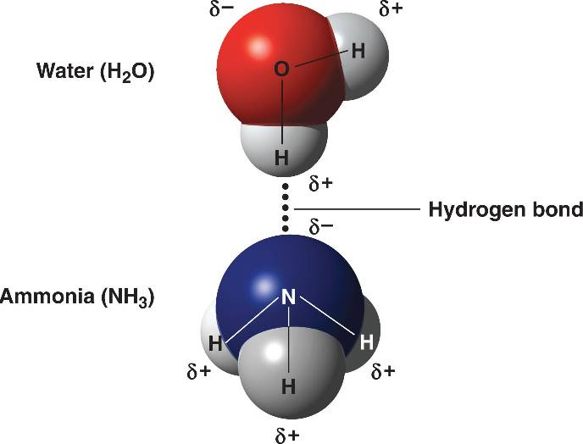
Hydrogen Bonds
A hydrogen bond (H-bond) is a type of attractive (dipole-dipole) interaction between an electronegative atom and a hydrogen atom bonded to another electronegative atom.
Notes:
Hydrogen bonds are for two reasons important in protein structure: for the hydrophobic effect and for the formation of secondary structure.

Slide 21
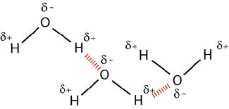
H-Bonds in water
The oxygen atoms in water (H2O) are electronegative, and therefor good hydrogen bond donors.

Slide 22
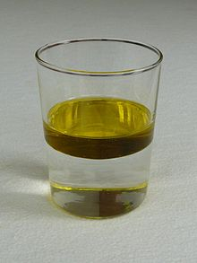

The hydrophobic effect
oil and water do not mix well
Typical oil molecules contain a lot of carbons, without the capability of forming hydrogen-bonds
Notes:
Hydrophobic residues are like oil in water.

Slide 23
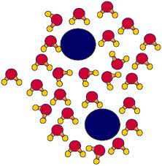
What is the problem?
What will happen do the blue “oil-like” molecules?

Slide 24
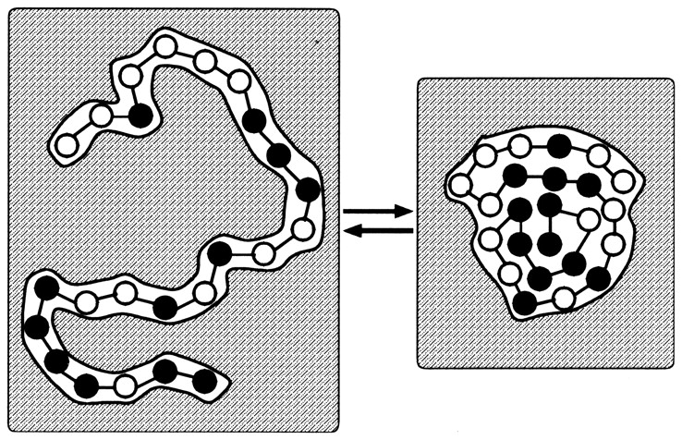
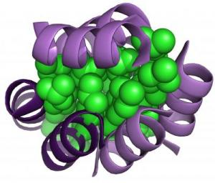
Hydrophobic Collapse – simple 2 amino acid model
hydrophobic amino acid
hydrophilic amino acid
Unfolded
Molten Globule
Folded
The buried hydrophobic amino acids are the largest contributor to the folded protein’s stability

Slide 25
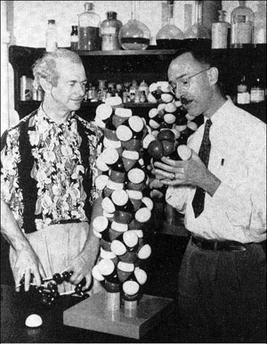
Secondary structure
In 1951 Pauling, Robert Corey, and Herman Branson correctly proposed the alpha helix and beta sheet as the primary structural motifs in protein secondary structure based on the (1) planarity of the peptide bond, (2) favourable hydrogen bonding patterns and (3) steric hindrance.
Pauling and Corey with their model of the alpha helix, 1951. © Copyright California Institute of Technology.

Slide 26
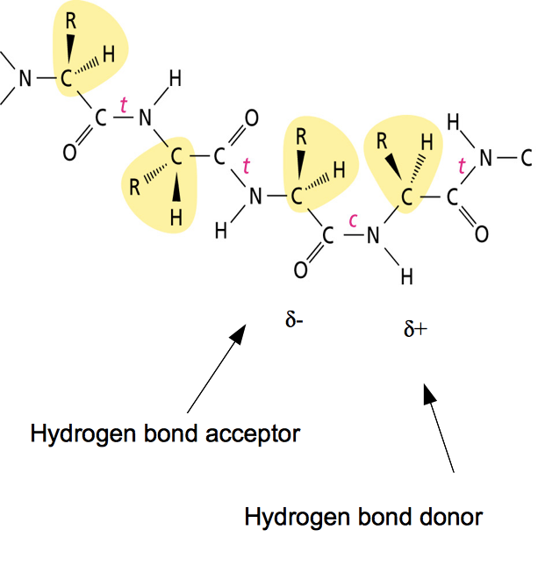
H-Bonds in the peptide backbone
The peptide backbone has one hydrogen bond donor and one hydrogen bond acceptor per residue

Slide 27
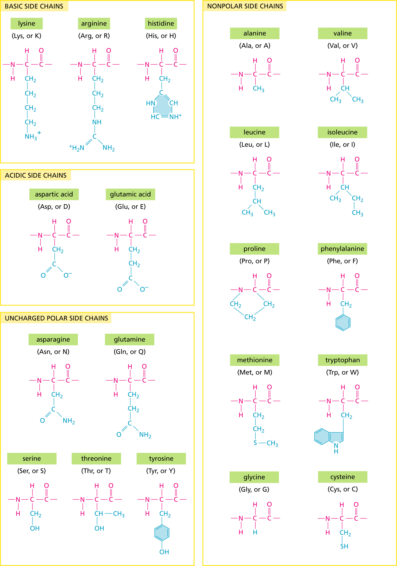
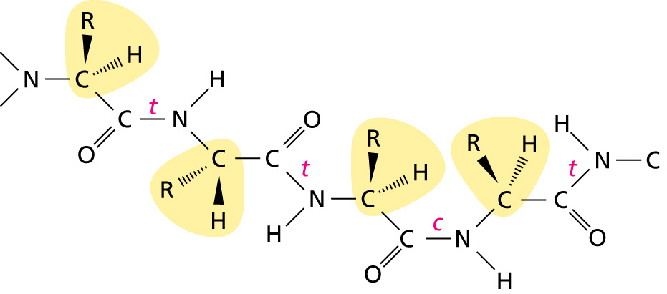
Primary Protein Structure
+ve charge
hydrophobic
Backbone has a hydrogen bond donor and acceptor per residue
-ve charge
other polar
δ-
δ+

Slide 28
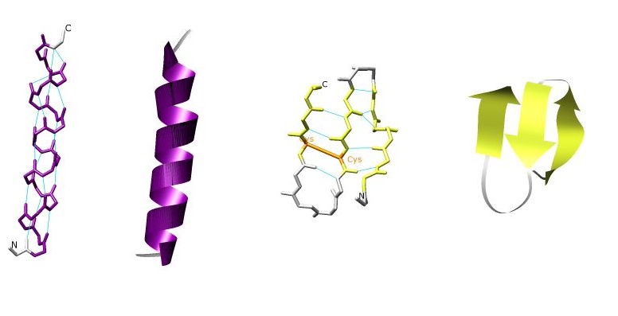
Hydrogen bonds & secondary structure of backbone
alpha helix
beta sheet
We will ignore this in the practical exercises!

Slide 29
Questions for you:
Would secondary structures form / be stable in vacuum?
What is the influence of water molecules on secondary structure formation (does it help, does it hinder formation)?
How can you explain secondary structure formation in an aqueous environment?

Slide 30
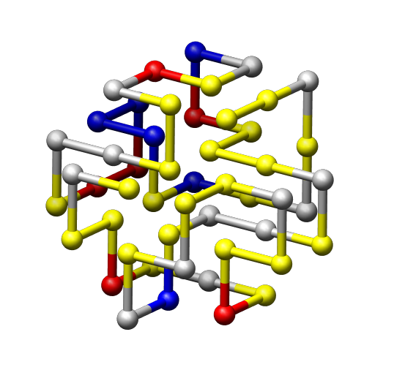
What are the major effects that contribute to a stably folded protein?
Hydrophobicity (oil in water)
  - note this is an effective force that contains enthalpic and entropic components
2) Hydrogen bonds form secondary structure

Slide 31
What forces / effects destabilize a folded protein?
Chain entropy!

Slide 32
The biological approach or the physical approach?
  TASK:
  Given a protein sequence predict in which 3D structure the protein will fold.
  So WHY does biology win?

Slide 33
Entropic and enthalpic contributions compensate (experimental)
Look at the scale of the axes!
Notes:
Thermodynamic functions specifying myoglobin stability: unfolding enthalpy (DH), entropy factor (TDS) and Gibbs energy (DG)

Slide 34
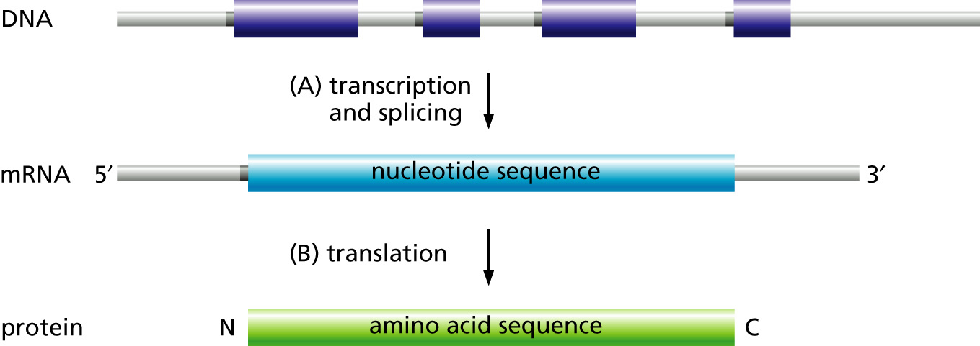
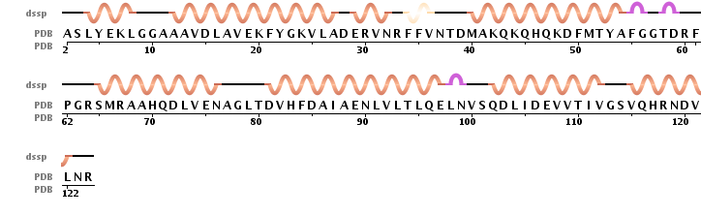
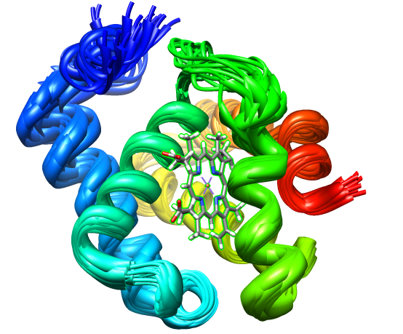
Physics & Biology: folding specificity
Unique characteristic:
The sequence of a protein determines and specifies its structure
Sequences evolve!

Slide 35
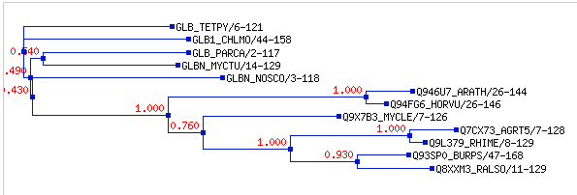
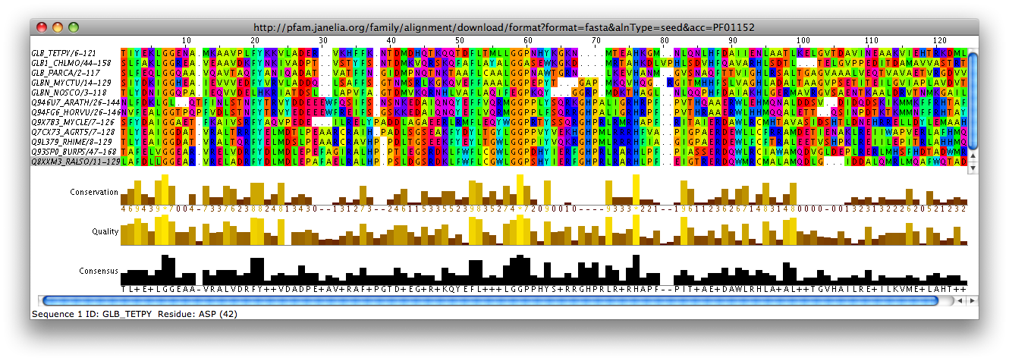
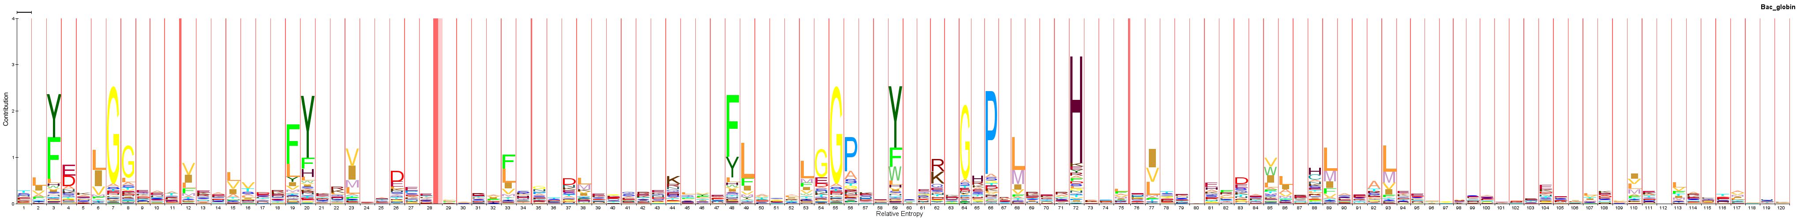
What can evolutionary history tell us?

Slide 36
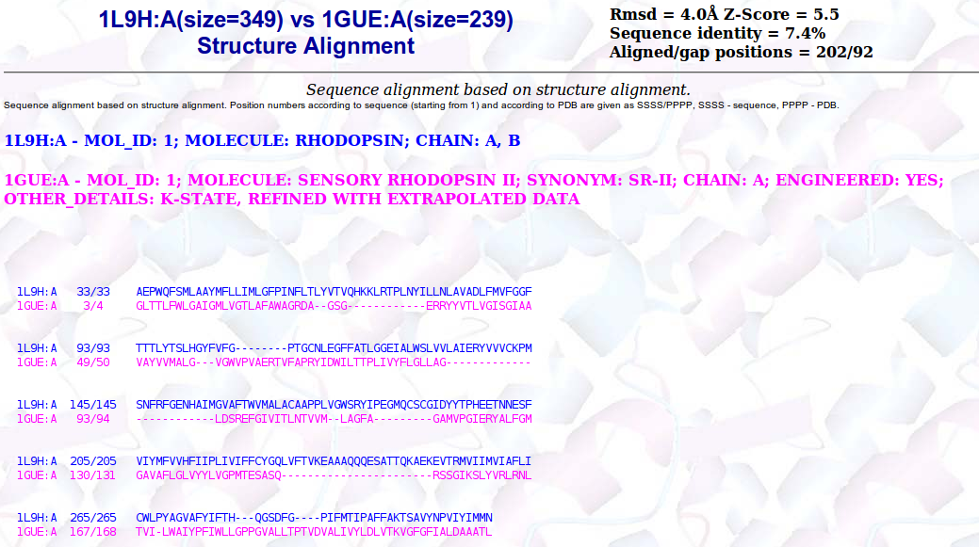
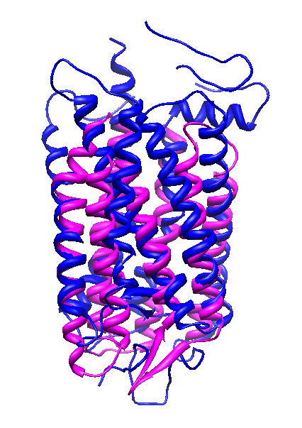
Biology: structure is more conserved than sequence
So if we have a protein with a known structure that has a similar sequence – we have solved our problem.
Notes:
Consequence: something with a similar sequence has a similar structure

Slide 37
So is there any role for physics based approaches?
Biological questions (qualitative):
  What is the function of this protein in the cell?
  What happens if we change the sequence of the protein?
  Where does the substrate bind?
  Do evolutionary related proteins bind the same substrate
Physical questions (quantitative):
How stable is this protein
Under which conditions will this protein fold?
How strong is the binding to a substrate?
Are there meta-stable states on the folding pathway?
Notes:
Last year, when I was walking around the poster session, I saw that about half of you worked on biological simulations. From DNA to proteins. Here we will focus on what sets biomolecular simulations apart from other simulations. And which relevant biology you should consider.

Slide 38
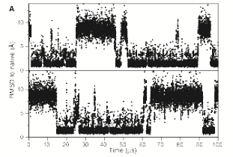
So is there any role for physics based approaches?
  Fundamental understanding of mechanisms and forces involved in folding
  Detailed simulations under (experimental) constraints.
  Predictions at changing conditions (e.g. temperature, pressure, concentration, pH)
Notes:
Last year, when I was walking around the poster session, I saw that about half of you worked on biological simulations. From DNA to proteins. Here we will focus on what sets biomolecular simulations apart from other simulations. And which relevant biology you should consider.

Slide 39
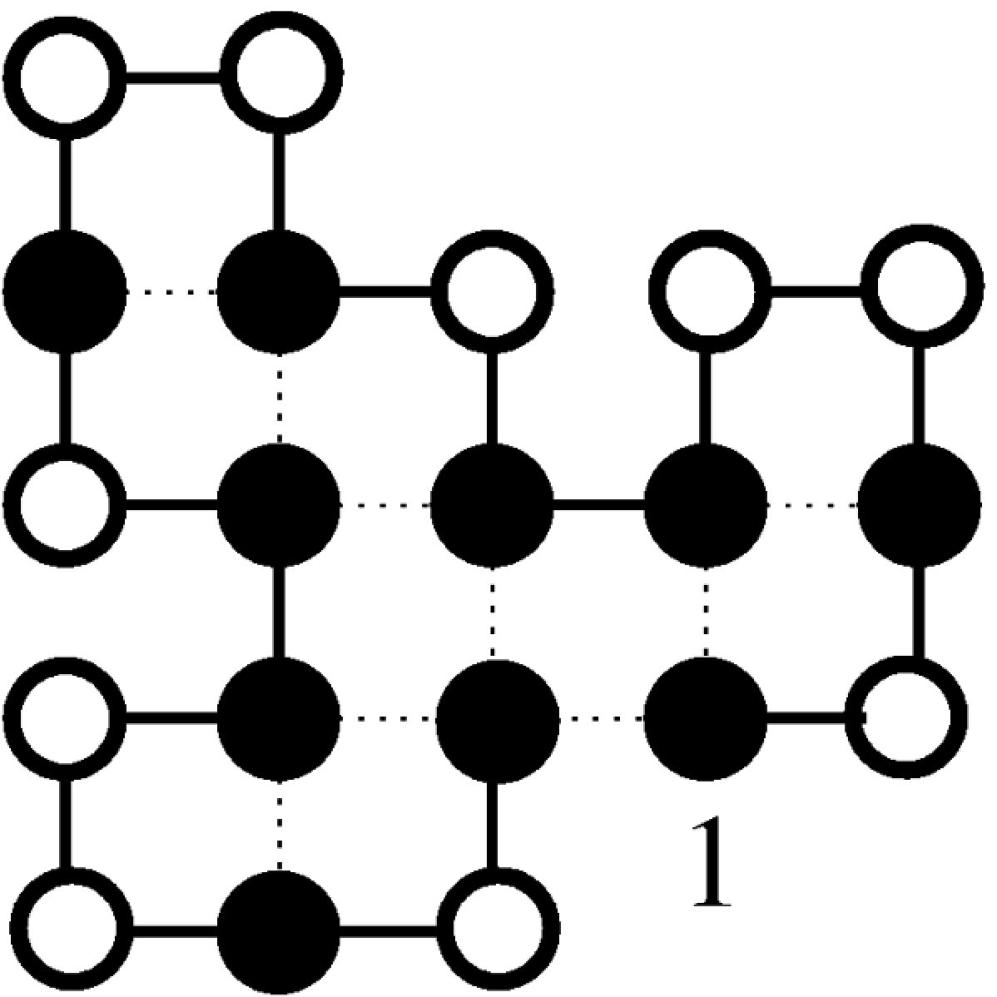
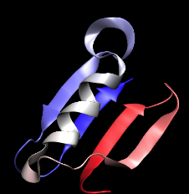
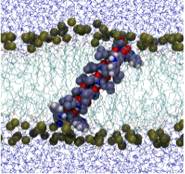
Why use simple models?
HP model - minute
cubic lattice model - hour
backbone model - week
full atomistic model - months-years
  Sampling lowest free energy state
  Different conditions
  Larger systems
Notes:
4 models
HP - hydrophobic -hydrophilic, folding in specific structure
Cubic - 20 amino acids, 3D
Backbone, amino acid interactions still based on distance, backbone structure realistic (phi/psi, hydrogen bonding, steric restraints)
Full atomistic, takes long time
BUT USE FOR THE RIGHT PURPOSE

Slide 40
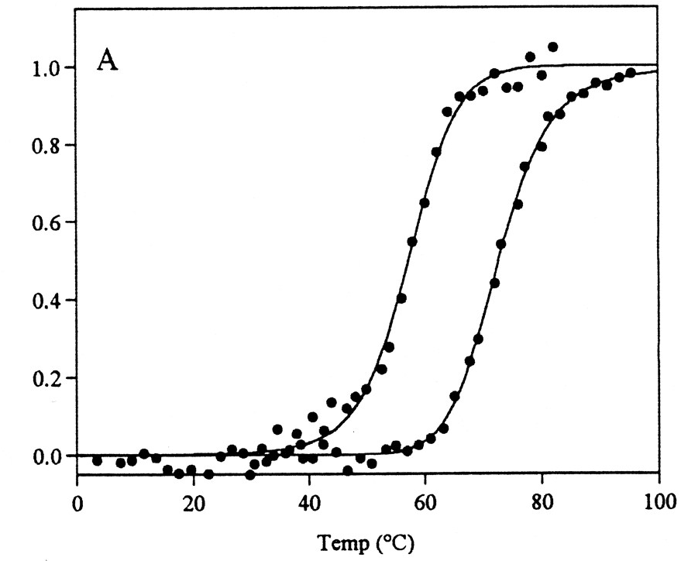
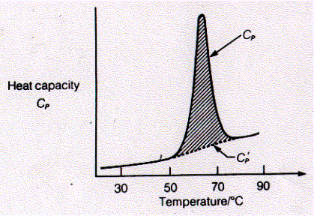
Physics: folding specificity - perfect self assembly
Experimental curves – can we understand these?
Amount of unfolding

Slide 41
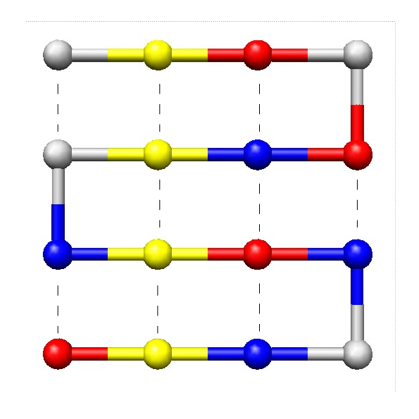
A very simple model
3D for research
  20 amino acid types
2D in practical
  4 amino acid types
  (4 different colours for the beads)

Slide 42
Lattice Model –
Sequence
Structure
Interaction energies
simple 4 amino acid model
hydrophobic
-- | + | + | +
+
+ |  | + | -
+ |  | - | +
polar (hydrophilic)‏
negative charge
positive charge
Notes:
Matrix !!!!

Slide 43
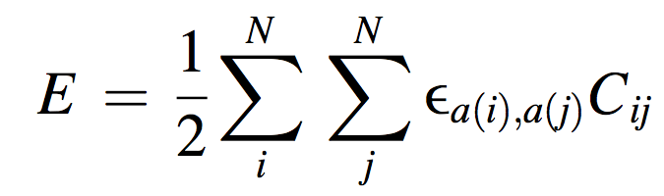
Simulation: interaction potential
energy
contact
hydrophobic
--
+
+
+
polar (hydrophilic)‏
+
negative charge
+
+
-
positive charge
+
-
+

Slide 44
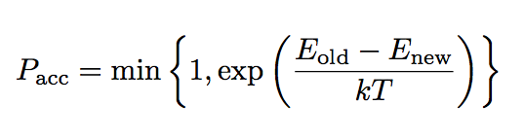
Simulation: Monte Carlo
Monte Carlo:
  Choose a residue (or region)
  Change its position
  Calculate new interaction energy
  Accept with Monte Carlo criterion
Shakhnovich & Gutin 1993 PNAS 90
Coluzza et al 2003 Phys Rev E 68
Betancourt & Thirumalai 1999 Protein Sci 8

Slide 45
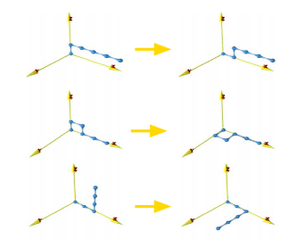
Simulation: Lattice Moves
corner flip
crankshaft
point rotation

Slide 46
Lattice Model: Potential, Design & Simulation
Folding Simulation
Sequence Design
Interaction Potential
hydrophobic
hydrophobic
--
+
+
+
polar (hydrophilic)‏
polar (hydrophilic)‏
+
negative charge
negative charge
+
+
-
positive charge
positive charge
+
-
+
Notes:
Matrix !!!!

Slide 47
Sequence Design
Design
Simulation
Potential
hydrophobic
hydrophobic
--
+
+
+
polar (hydrophilic)‏
polar (hydrophilic)‏
+
negative charge
negative charge
+
+
-
positive charge
positive charge
+
-
+

Slide 48
Problem: how to create a folding sequence?
We cannot take real protein sequences (why not?)
?
In nature evolution ensures folding...

Slide 49
Solution: energy minimization
Given a structure, what are sequences with a low (potential) energy?
?
we can simulate evolution by changing the sequence with random substitutions

Slide 50
Lattice Model: design
hydrophobic
polar (hydrophilic)‏
-- | + | + | +
+
+ |  | + | -
+ |  | - | +
negative charge
positive charge
Design loop:
-Initiation: choose a structure, keep it frozen
- Design loop:
  Choose a residue
  Change the amino acid
  Calculate new interaction energy
  Accept with Monte Carlo criterion based on energy and variance
Notes:
Matrix !!!!

Slide 51
Sequence design: energy minimization
Note that this is an “ad hoc” usage of the MC algorithm – no statistical mechanics, pure energy minimisation

Slide 52
Cubic Lattice Model
Cheap & simple
  Use for right purpose
Can model:
  General trends
  Folding specificity
  Heat capacity
  Binding and unbinding
Not captured:
  Secondary structure
  Hydrophobic effect
  (cold denaturation)
  Structure predictions for specific proteins
Shakhnovich & Gutin 1993 PNAS 90
Coluzza et al 2003 Phys Rev E 68
Notes:
Protein structure no need to introduce, explain model used
Pair interactions, 20 amino acids (necessary)
Can fold in v. specific DESIGNED structures, shows from heat capacity curve
BUT use for the right purpose (general trends/behaviour scanning)

Slide 53
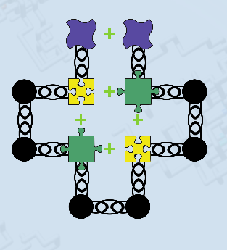
Interactions: toy example 2D
matching puzzle pieces indicate favourable interaction energies
Tutorial code is based on this toy example

Slide 54
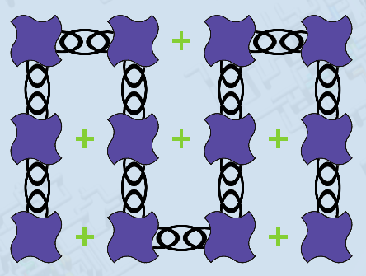
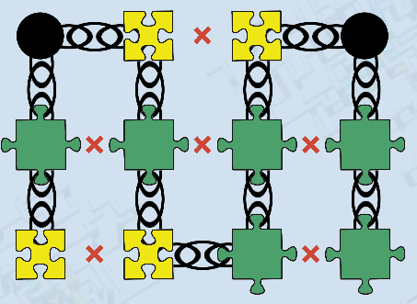
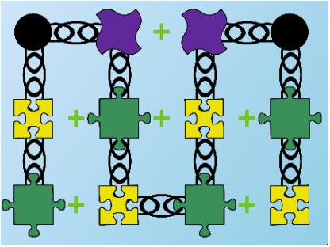
Sequence Design: what would be a good (specific) folder
Low energy
High variance
Good folder

Slide 55
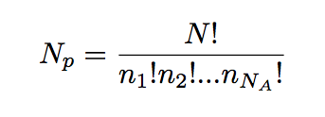
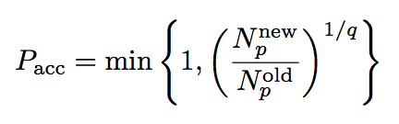
Sequence Variance
Notes:
Thinking about it, this should probably be optimized for information entropy
So what measure would we use for natural distributions – model p(x) differently for different types

Slide 56




Sequence Variance & Biology
Take variance estimates from amino acid type occurrence

Slide 57
How to derive a potential?
hydrophobic
--
+
+
+
?
polar (hydrophilic)‏
+
negative charge
+
+
-
positive charge
+
-
+
Can we use experimental biological data?
(data mining)

Slide 58
“Knowledge Based” Amino Acid Pair Potentials
Sample the PDB
Nearly 100.000 protein structures (X-ray, NMR, Cryo)
Assumption:
PDB is a representative ensemble of well mixed amino acids

Slide 59


“Knowledge Based” Amino Acid Pair Potentials
H₂O
- | + | + | +
+ | -
+ |  | + | -
+ |  | - | +
-- | + | + | +
+ | -
+ |  | + | -
+ |  | - | +
hydrophobic
?
polar (hydrophilic)‏
negative charge
positive charge
H₂O
Miyazawa & Jernigan 1993 Protein Eng 6
Betancourt & Thirumalai 1999 Protein Sci 8
observed contacts
-
expected contacts
Notes:
Here I show the basic idea behind such potentials. The real potential have some additional corrections

Slide 60

“Knowledge Based” Amino Acid Pair Potentials
--
+
+
+
+
+
+
-
+
-
+

Slide 61
Are experimental results captured by the model?
Amount of unfolding

Slide 62
Let’s start the Monte Carlo Simulation
Monte Carlo:
  Choose a residue (or region)
  Change its position
  Calculate new interaction energy
  Accept with Monte Carlo criterion
Shakhnovich & Gutin 1993 PNAS 90
Coluzza et al 2003 Phys Rev E 68
Betancourt & Thirumalai 1999 Protein Sci 8

Slide 63
Free energy curve of folding
Free energy (kT)
denatured state
native state
Native contacts
Proteins fold into a specific native structure, given their sequence
What would happen if we raise the temperature?

Slide 64

Folding Specificity on the Lattice
Notes:
Add folding curve

Slide 65

Foldable, with high specificity
Heat capacity
Temperature
Notes:
Still does what classic lattice model does

Slide 66
Full atom vs coarse grained folding
free energy (kT)
number of native contacts
Shaw, D. E., et al. (2010) Science, 330

Slide 67

Full atom vs coarse grained folding
Native Contacts
MC steps
Shaw, D. E., et al. (2010) Science, 330
(thanks to Erik van Dijk)

Slide 68
Protein folding Specificity
Proteins fold into a specific native structure
Folded structure => energetically favorable
Unfolded structure => entropically favorable
At higher temperatures, proteins become unstructured

Slide 69
Cubic Lattice Model
Cheap & simple
  Use for right purpose
Can model:
  General trends
  Folding specificity
  Heat capacity
  Binding and unbinding
Not captured:
  Secondary structure
  Hydrophobic effect
  (cold denaturation)
  Specific proteins
Shakhnovich & Gutin 1993 PNAS 90
Coluzza et al 2003 Phys Rev E 68
Notes:
Protein structure no need to introduce, explain model used
Pair interactions, 20 amino acids (necessary)
Can fold in v. specific DESIGNED structures, shows from heat capacity curve
BUT use for the right purpose (general trends/behaviour scanning)

Slide 70

The hydrophobic effect and its influence on protein folding and aggregation

Slide 71


Amyloid fibrils
folded proteins
amyloid fibrils
It is this hydrophobic force that drives protein folding

Slide 72
Amyloid fibrils
Proteins aggregated in parallel β-strands
Aggregating region generally hydrophobic
Some fibrils denature at low temperatures
  (Ikenoue et al., 2014)
Highly toxic, involved in many neurodegenerative diseases
  Alzheimer
  Parkinson
  BSE / Mad cow
  Huntington
The mechanism behind amyloid fibril formation is poorly understood
Notes:
Alzheimer, BSE (mad cow disease) heating etc.
Very stable → why?
Seeding
Seeding vs. elongation
Crystal structures of fibrils
Cold denaturation
ITC experiment

Slide 73

Emergent behaviour (entropy & enthalpy)
Hydrophobic force has a maximum around 70 - 80 °C
(due to entropy enthalpy compensation)
Hydrophobic particle
Absorption of methane in water
Oil
Water
Widom Phys. Chem. Chem. Phys., 2003; Gallagher 2003, JACS; Huang and Chandler PNAS 2000
Notes:
For small hydrophobic particles, for example for small alkanes, this can be measures by experiment. Moreover, there is now a good theoretical framework to understand the hydrophobicity of small particles with respect to temperature, and this is the figure you see on the left.
For simplcity, we can assume that this shows what the cost is to transfer a small hydrophobic cavity from oil to water. We see a peak around 70-80 degrees Celsius. Moreover, we can see that the hydrophobic force actually becomes weaker at lower temperatures.

Slide 74

The strength of the hydrophobic effect depends on temperature
van Dijk, Hoogeveen & Abeln; 2015
Contact between amino acid and solvent
By mining experimental protein structures at different temperatures we could show that the hydrophobic effect in proteins becomes weaker at lower temperatures

Slide 75


Some proteins denature at low temperature
$$∆G=∆H−T∆S$$
At low temperatures, the enthalpic factor dominates and proteins are folded
At high temperatures, the entropic factor dominates and proteins denature
However, some proteins also denature at very low temperatures
(Dias, 2010; Jeppesen, 2010; van Dijk et al., 2016; Pucci, 2014)

Slide 76

Can the temperature-dependence of the hydrophobic effect explain cold-denaturation of amyloid fibrils?

Slide 77

Theory: hydrophobic effect and enthalpic component
s
Temperature (Kelvin)

Slide 78
Adding hydrophobic temperature dependence to amyloid formation
Experimental protein structures
Lattice models with beta strands
Folded protein
Amyloid fibril

Slide 79

Simulation: Cold collapse of amyloid fibrils

Slide 80


Simulation and theory: thermodynamic signatures - model
Simulations
Theoretical contributions from the hydrophobic effect
The hydrophobic temperature dependence can explain the enthalpic, but not the entropic behavior of the system

Slide 81


Experiment: confirms enthalpic signature
All cold denaturing fibrils show negative slopes
Measurements Buell lab:

Slide 82


The estimated strength of the hydrophobic effect is directly related to the hydrophobicity of the aggregating region of the fibril
$$αA_{h}$$
Buried hydrophobic surface ($A_{h}$)
Linear relation between
aggregating hydrophobic surface area
strength of the hydrophobic temperature dependence

Slide 83

So will this be the new treatment for Alzheimer?
Only alpha-synuclein denatures at temperatures above freezing.

Slide 84



Acknowledgements & citations
Dijk, Erik van, Juami Hermine Mariama van Gils, Alessia Peduzzo, Alexander Hofmann, Georg Groth, Halima Mouhib, Daniel E. Otzen, Alexander K. Buell, and Sanne Abeln. 2019. “The Hydrophobic Effect Characterises the Thermodynamic Signature of Amyloid Fibril Growth,” June. http://arxiv.org/abs/1906.05620.
van Dijk, Erik, Patrick Varilly, Tuomas P. J. Knowles, Daan Frenkel, and Sanne Abeln. 2016. “Consistent Treatment of Hydrophobicity in Protein Lattice Models Accounts for Cold Denaturation.” Physical Review Letters 116 (7): 078101.
Abeln, Sanne, Michele Vendruscolo, Christopher M. Dobson, and Daan Frenkel. 2014. “A Simple Lattice Model That Captures Protein Folding, Aggregation and Amyloid Formation.” Edited by Ilia V. Baskakov. PLoS ONE 9 (1): e85185.
Ni, Ran, Sanne Abeln, Marieke Schor, Martien A. Cohen Stuart, and Peter G. Bolhuis. 2013. “Interplay between Folding and Assembly of Fibril-Forming Polypeptides.” Physical Review Letters 111 (5): 058101.
Dijk, Erik van, Arlo Hoogeveen, and Sanne Abeln. 2015. “The Hydrophobic Temperature Dependence of Amino Acids Directly Calculated from Protein Structures.” PLOS Computational Biology 11 (5): e1004277.
Dijkstra, M.J.J, W.J. Fokkink, J Heringa, E van Dijk, and S Abeln.
“The Characteristics of Molten Globule States and Folding Pathways Strongly Depend on the Sequence of a Protein.” Mol. Phys. 2018

Slide 85
Vacancy for PhD student biophysics
Biophysics 4 years
  Experiments and simulation on proteins involved in Alzheimer and other neurodegenerative disease
  Within ITN project on biomarkers for neurodegenerative disease: MIRIADE
  Not have resided in the Netherlands for more than 12 months in the 3 years immediately before the recruitment date
Also a 4 year Bioinformatics / Machine Learning PhD position available
Contact: s.abeln@vu.nl

Slide 86
References
Abeln, S., & Frenkel, D. (2008). Disordered flanks prevent peptide aggregation. PLoS Comput. Biol., 4(12), e1000241. doi:10.1371/journal.pcbi.1000241
Abeln, S., & Frenkel, D. (2011). Accounting for protein-solvent contacts facilitates design of nonaggregating lattice proteins. Biophys. J., 100(3), 693–700. doi:10.1016/j.bpj.2010.11.088
Abeln, S., Vendruscolo, M., Dobson, C. M., & Frenkel, D. (2014). A Simple Lattice Model That Captures Protein Folding, Aggregation and Amyloid Formation. PLoS ONE, 9(1), e85185. doi:10.1371/journal.pone.0085185
Ni, R., Abeln, S., Schor, M., Cohen Stuart, M. A., & Bolhuis, P. G. (2013). Interplay between Folding and Assembly of Fibril-Forming Polypeptides. Physical Review Letters, 111(5), 058101. doi:10.1103/PhysRevLett.111.058101
Ni, R., Kleijn, J. M., Abeln, S., Cohen Stuart, M. a., & Bolhuis, P. G. (2015). Competition between surface adsorption and folding of fibril-forming polypeptides. Physical Review E, 91, 1–5. doi:10.1103/PhysRevE.91.022711
van Dijk, E., Hoogeveen, A., & Abeln, S. (2015). The Hydrophobic Temperature Dependence of Amino Acids Directly Calculated from Protein Structures. PLOS Computational Biology, 11(5), e1004277. doi:10.1371/journal.pcbi.1004277
van Dijk, E.; Varilly, P.; Knowles, T.; Frenkel, D.; Abeln, S. Consistent treatment of hydrophobicity in protein lattice models accounts for cold denaturation. ArXiv e-prints 2015, [arXiv:cond-mat.soft/1511.06590] – accepted PRL

